Slide 1
MULTI BANKING SYSTEM

Slide 2
ABSTRACT
Nowadays the use of bank applications has increased and many banking operations are done online. In this paper we proposed a multi banking system using web services (for transactions). It is developed for those customers who are having multiple accounts in various banks. Multi-banking interface is a web-based application through which customer can access his/her multiple accounts with single user id and password. The customer does not have to remember all the user id and password for each account he/she has in a banking website. The objective of this application is to allow the Customers of various Banks access their accounts and make transactions using this solution. They need not interact with various bank applications or web sites. The customer can login with single id and password. In addition to this, the customer has certain privileges such as he/she can view his/her transaction and account details and also make fund transfers from one bank account to other. Also, user can create various bank account in a single application.

Slide 3
HARDWARE SPECFICATION
Processor : P 4 700 GHz.
RAM : 4 GB RAM
Hard Disk Drive : 180 GB

Slide 4
SOFTWARE SPECIFICATION
Operating System : Windows 7/8/10
Front End : JAVA
Back End : SQL

Slide 5
EXISTING SYSTEM
Currently we are having lot of banks in the market and any person can do transactions of any individual bank either manually or in online. But no one can do all banks transactions in a single portal or in single bank.
Disadvantages
Customer need to use multi software for different account
Waste of time for just create an bank account
Single workers can able to handle the customer account

Slide 6
PROPOSED SYSTEM
The Multi Banking System Interface is targeted to the future banking solution for the users who is having multiple bank accounts in multiple banks. This interface integrates all existing banks and provides business solutions for both retail and corporate.
Advantages
By using this portal any client who maintain accounts in various banks can directly log on to Multi Banking System Interface and make any kind of transactions.
Can access different bank account details in an single application
All the action has taken care by single application

Slide 7
Modules
Bank Registration
Admin first login into the banking system and create linked bank details, once the admin creates the bank it will shown in the all the requested places. Admin provide all the information about the bank.
Manager Registration
Admin also have access to create manager under respective banks. this is a big process to add the manager details. Once the manager allots to the bank, he gave access to managing the customer details.
Customer Registration
Customer manually select the bank and give request to the respective bank manager; manager decide to check the customer details and give approve request. Once the customer got access the account will be created.

Slide 8
Approve and Reject request
This module will be handling by the bank manager, once manager get customer account request, just verified and do the action for approve or reject.
Create Bank Account
By default, it will create after the manager approving customer request. Once the account has created the customer can able to login and check the account details.
customer details Report
Manager can view the all the customer details as well in a single window. Once the customer has approved status the customer has shown in this window.

Slide 9

Data Flow Diagram
Level 0

Slide 10
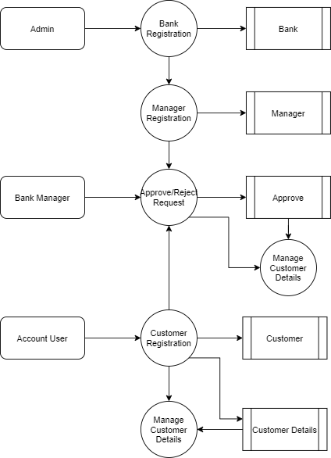
Level 1:

Slide 11
TABLE DESIGN TABLE NAME:ADMIN
FIELD | DATA TYPE | SIZE | CONSTRAINT
Admin id | Int | 10 | Primary key
Username | Varchar | 30 | Not null
password | Varchar | 30 | Not null

Slide 12
TABLE NAME:Bank
FIELD | DATA TYPE | SIZE | CONSTRAINT
Bank id | Int | 10 | Primary key
Bankname | Varchar | 20 | Not null
Brachname | Varchar | 20 | Not null
Address | Varchar | 30 | Not null
Landline | Int | 10 | Not null
Ifsccode | Varchar | 15 | Not null

Slide 13
TABLE NAME:Manager
FIELD | DATA TYPE | SIZE | CONSTRAINT
Manager id | Int | 10 | Primary key
Bank id | Int | 10 | Foreign key
Brach name | Varchar | 30 | Not null
Mobile | Int | 10 | Not null
Landline | Int | 10 | Not null

Slide 14
TABLE NAME:CUSTOMER
FIELD | DATA TYPE | SIZE | CONSTRAINT
Customer id | Int | 10 | Primary key
Firstname | Varchar | 20 | Not null
Lastname | Varchar | 20 | Not null
Mobile | Int | 10 | Not null
Aadhar | Int | 20 | Not null
License | Varchar | 20 | Not null
Age | Int | 2 | Not null
Gender | Varchar | 7 | Not null
Address 1 | Varchar | 30 | Not null
Address 2 | Varchar | 30 | Not null
City | Varchar | 10 | Not null
State | Varchar | 10 | Not null
Pincode | Int | 6 | Not null

Slide 15
TABLE NAME:Transaction
FIELD | DATA TYPE | SIZE | CONSTRAINT
Customer id | Int | 10 | Primary key
Firstname | Varchar | 20 | Not null
Lastname | Varchar | 20 | Not null
Mobile | Int | 10 | Not null
Aadhar | Int | 20 | Not null
License | Varchar | 20 | Not null
Age | Int | 2 | Not null
Gender | Varchar | 7 | Not null
Address 1 | Varchar | 30 | Not null
Address 2 | Varchar | 30 | Not null
City | Varchar | 10 | Not null
State | Varchar | 10 | Not null
Pincode | Int | 6 | Not null

Slide 16
TABLE NAME:Approve
FIELD | DATA TYPE | SIZE | CONSTRAINT
Approve id | Int | 10 | Primary key
Bank id | Int | 10 | Foreign key
Customer id | Int | 10 | Foreign key
Approve status | Varchar | 7 | Not null

Slide 17
Thank You

